Slide 1
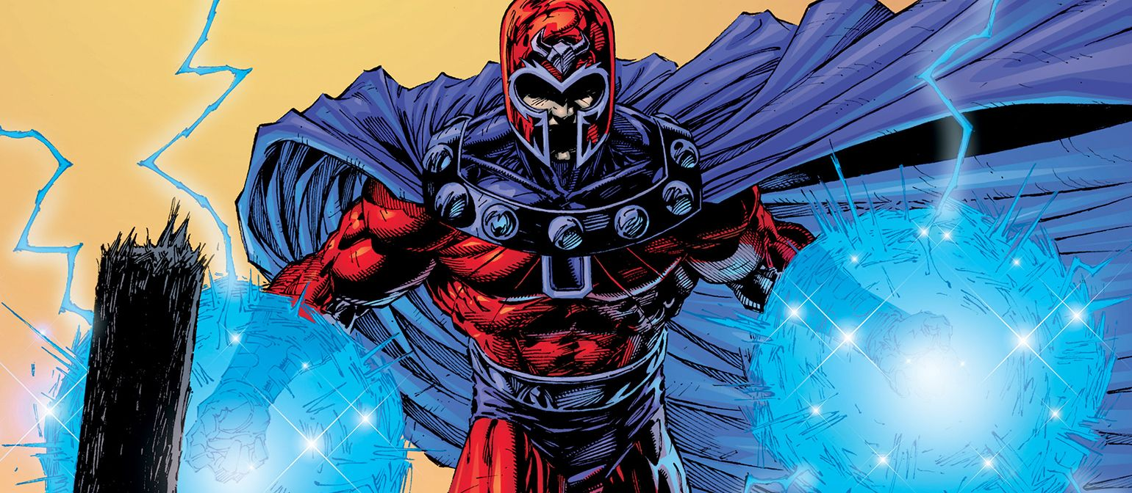
Magneto Was Right
Capstone Project Steven Wooden 8/31/2024

Slide 2
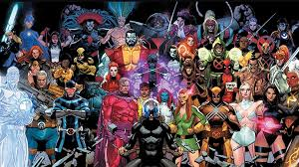
Introduction
Magneto Was Right is a platform for X-Men enthusiasts, which offers character bios, blog posts, and fan art. If you want to get to know about the different characters of the mutant universe, want to know what's new in the world of X-Men, or just want to share your own interest and art, this app provides a platform for you to express it.

Slide 3
Purpose
The purpose of this project was to bring people together online through shared interest and fandom of the X-Men and mutant universe. Creating a place dedicated to this specific need to share content, art, news and celebrate these characters and stories we have come to love. The app tries to provide a community with features that allow users to engage with X-Men content, characters and contribute to broader discourse of X-Men!

Slide 4
Industry
The project falls under the entertainment and media industry. I think this industry is very competitive for platforms trying to capture the attention of different fan groups. Making sure that the app fosters engagement and provides high quality content at large could be a challenge because it is a niche topic. However, I do think it is relevant to this industry because of the resurgence of different X-Men media like the Krakoa Era in comics, or X-Men 97 on television, based on the growing want for more X-Men.
How does it fit?

Slide 5
Stakeholders
The shareholders for this app could span from fans and enthusiast for the app and engagement to content creators who want to share their own work or thoughts. I think overall they would want a dedicated space to explore X-Men and learn more about them. Overall, the stakeholders would want something that is easy to navigate and engage with. For instance, reading about different characters or submitting work online, the process should be very easy to go through.
Who are they and what do they get out of it?

Slide 6
Product Description

Slide 7
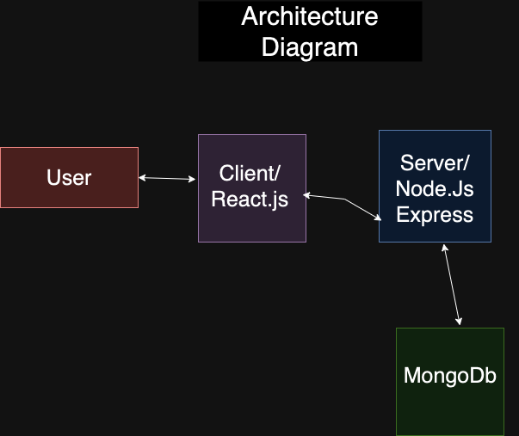
The User interacts with the client( Vite React) and makes demands. The client makes request to the server which finds the data in MongoDb and sends it back to the client.

Slide 8
User Stories
Dolores/ User 1
Goes to the Magneto Was Right looking for the latest news on the X-Men.
From the Home Page she either clicks the top navlink that's labelled Blog or scrolls to the bottom thumbnail labelled and clicks on link.
As she has navigated to the blog page she scrolls through the different posts.
She clicks on a button that says read or watch me and enjoys the content.
Eugene/ User 2
They want to find out more information about the different X-Men Characters.
From the Home Page they will click the nav link at the top of the screen labelled Character Bio or the thumbnail at the bottom of the screen.
Once on the page they are looking through the different Character Cards.
He clicks on one of the Accordions on the bottom of the Character Card and information is shown about the character.
Theresa/ User 3
They want to go to and upload content to contribute to this page.
From the Home Page they click the Submit Content link at the top nav bar.
On the Submit Content Page they start to fill out the information about the author of the content, title, image url, link etc. on the form.
They hit the submit button for the form
They go to the blog page to check if their content posted to the page

Slide 9
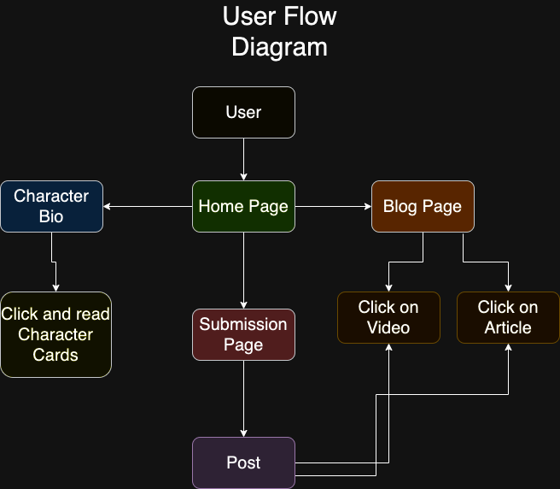
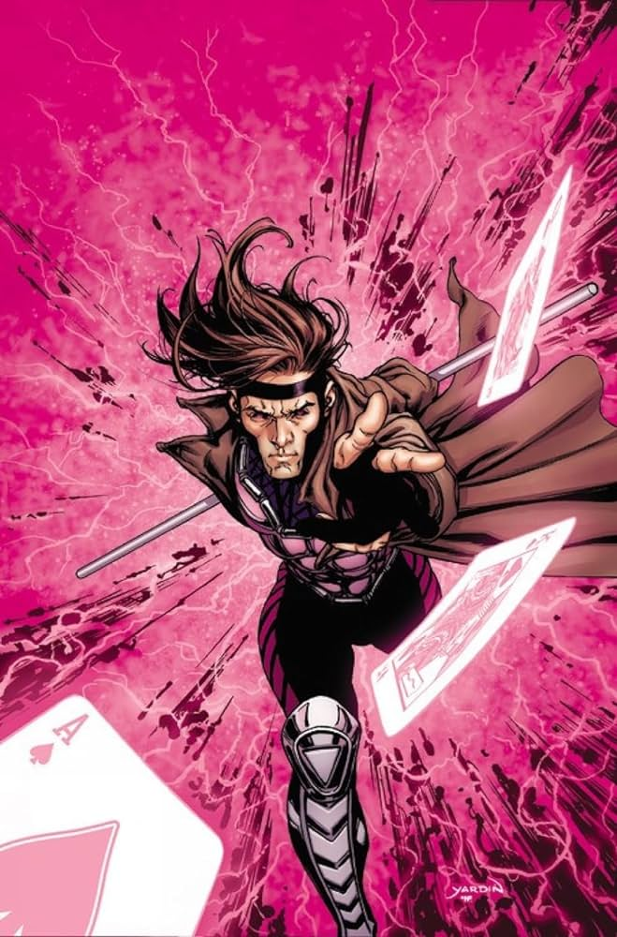

Slide 10
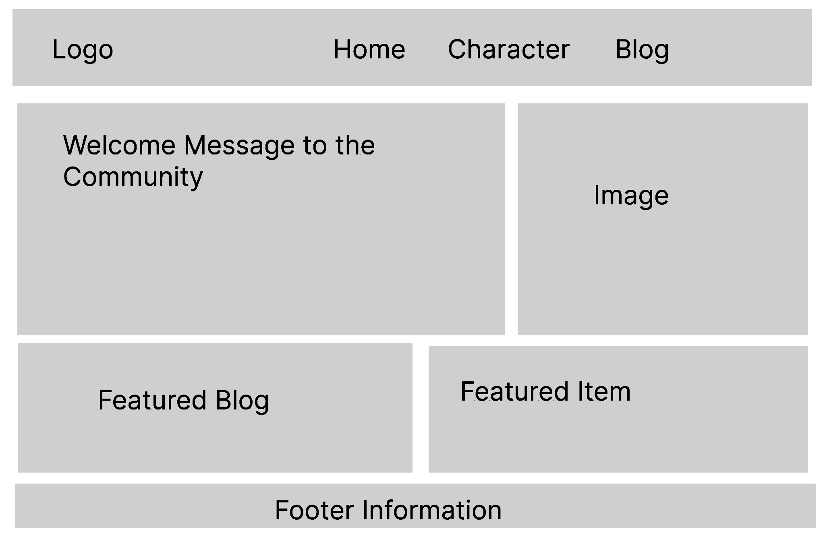
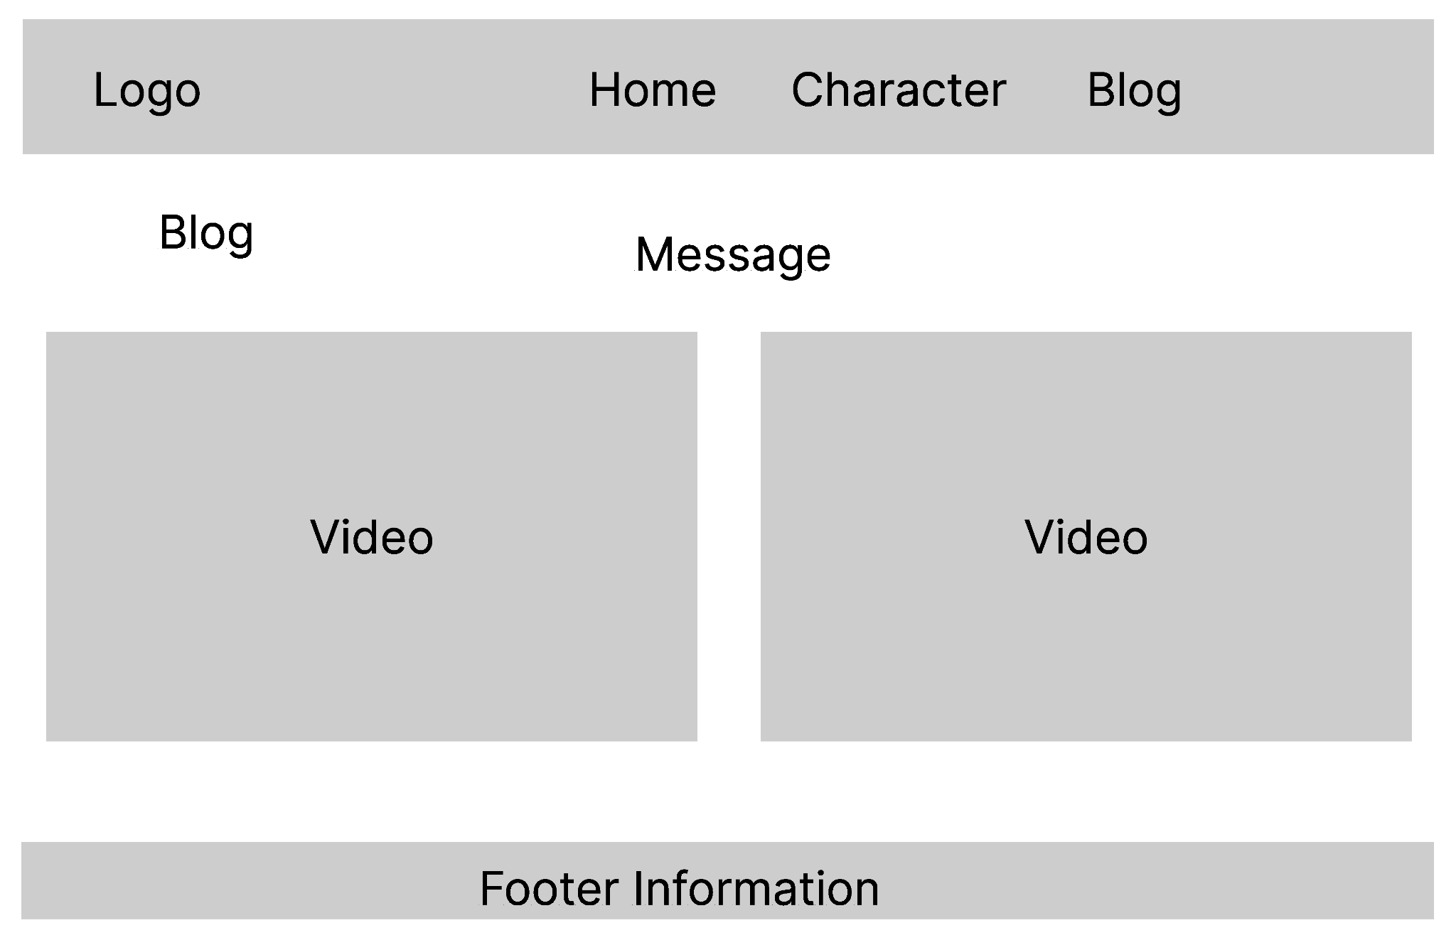
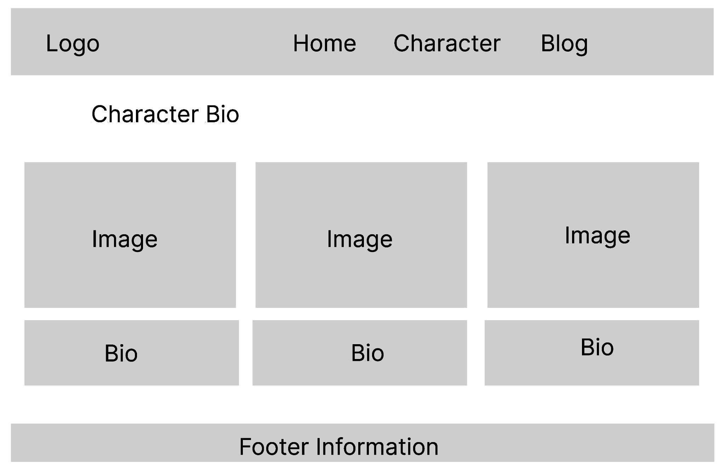
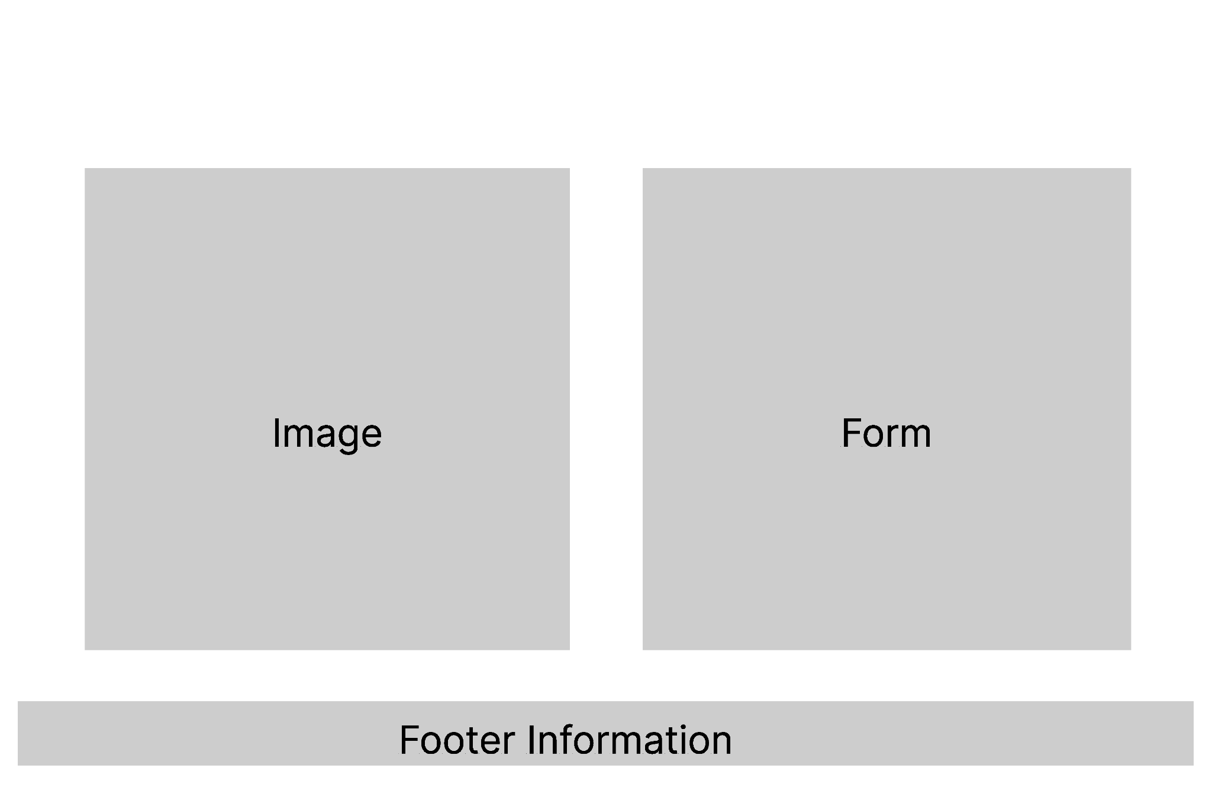
Wireframe Design -Lo Fi

Slide 11
Open Questions/ Out of Scope
Open Questions
What would go into creating a discussion form and would be the format?
Since the Post are open to anyone, how will it be moderated and will the content be reportable and be terminated?
Out of Scope
Users being able to login or signup and create their profiles with avatar.
Comment features on Posts to show
Build out a fully detailed database
Social Media so users can share content from the app

Slide 12
Non Functional Requirements
There should be a type of moderation to be able to place reports and remove inappropriate content.
Need to keep the UI to make sure it is easy to navigate for all
I need to make sure my app is deployable to cloud services
Making sure my app is responsive across all devices

Slide 13
TESTING STRATEGY
Tested the CRUD operations using Thunder Client to ensure performance. Testing how well the backend interacted with the database. I used handling responses to test the frontend when making API calls to send a console log response and in the backend when using Thunder Client to help with figuring out what's breaking.
MAINLY TESTED API, CRUD OPERATIONS AND MONGODB CONNECTION

Slide 14
End to End Solution
The Character Information loads successfully fetching data from the MongoDB
The Blog post loads successfully from fetching data from MongoDb as well as links and button features like turning the image into a video.
The Submit Content works because it POST all information that is filled in forms to the post collection which is fetched to the Blog page and post.
All CRUD operations work throughout app.
The app works end to end for each feature

Slide 15
References
GitHub - https://github.com/stevenwooden/MagnetoWasRightCapstone.git
MongoDB
React - Vite
Express
Node.Js
React-Bootstrap
Axios
Google Fonts
ThunderClient

